Slide 1
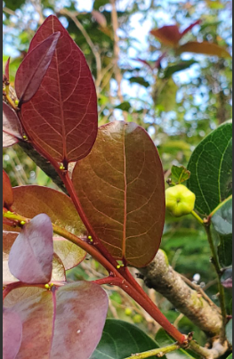
Phyllanthus mariannensis
The second meeting of
the Guam Native Plant Society
January 21, 2023

Slide 2
Sign up for email list

Slide 3
January plant of the month: Phyllanthus mariannensis (chosga): update
Taxonomy:
2011: Wagner and Lorence split Glochidion marianum into →
Phyllanthus mariannensis (Guam)
Phyllanthus seyavinianus (Pohnpei)
According to POWO (https://powo.science.kew.org/taxon/urn:lsid:ipni.org:names:77112714-1)
“This name [Phyllanthus mariannensis] was accepted following an alternative taxonomy by these authorities:
Govaerts, R., Nic Lughadha, E., Black, N., Turner, R. & Paton, A. (2021). The World Checklist of Vascular Plants, a continuously updated resource for exploring global plant diversity. https://doi.org/10.1038/s41597-021-00997-6. Scientific Data 8: 215.
But as of 12/20/2022, POWO still consider G. marianum to still be valid.
As of 12/20/2022, the IPNI (https://www.ipni.org/n/77112714-1) considers G. marianum to be a “replaced synonym” of P. mariannensis.
Does anyone know what is the most authoritative source for plant names?
JHale emailed GBIF to correct their website, which says the P. mariannensis is found on Pohnpei. They have contacted the Smithsonian and Bishop museum as of 12/20/2022

Slide 4
Chosga progress
Can we find someone to pronounce CHosga and Abas duendes for us?
JHale emailed Highways department and Komision about naming a street CHOSGA
Woodworking: working on an outing with MENH:LOM Wearable Wisdom if they would work the wood
Updating Wikipedia:
Any Wikipedia experts?
Article will be available soon?
Medicinal:
Considering a field trip to Amot Farms

Slide 5
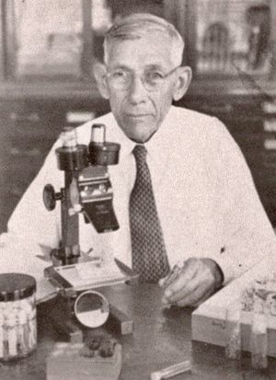

Entomology expeditions 1936
Otto Herman Swezey (1869 – 1959)
Robert Leslie Usinger (1912-1968)
https://en.wikipedia.org/wiki/Otto_Herman_Swezey
https://antwiki.org/wiki/Usinger,_Robert_Leslie_%281912-1968%29

Slide 6
 | Endemic insects | Non-endemic insects
Possible specialists (insects found ONLY on P. mariannensis) | Trioza guam (a jumping plant louse) Swezeylla muscosa (a weevil) Tartessus ochraceus (a leafhopper) | Chrysodema ventralis (a jewel beetle) Dictyophora nakanonis (Raivuna nakanonis) (a planthopper) Aneristus ceroplastae (a chalcid wasp)
Generalists (insects found on P. mariannensis but also found on other plants) | Cirrospiloideus guamensis (genus now Elachertus?) (a leafminer) Tartessus swezeyi (a leafhopper) Trigonops inaequalis (a weevil) Halictus swezeyi (a sweat bee) Notioxenus fulgidusI (a beetle) Aretas signatus (a beetle) Aretas bifasciatus (a beetle) Haptognathus minutus (a beetle) Calliphara munda (a beetle) Valanga excavata (a grasshopper) | Phytorus lineolatus (a leaf beetle) Microchrysa flaviventris (a soldierfly)

Slide 7
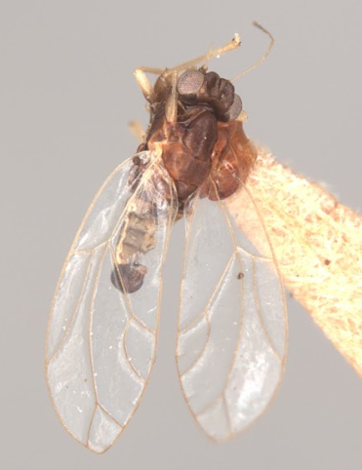
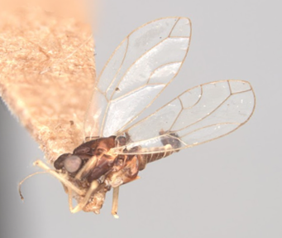
Trioza guama (syn. Trioza propria)
Collected 8/18/1936 on Phyllanthus mariannensis in Piti (has never been collected on any other plant)

Slide 8
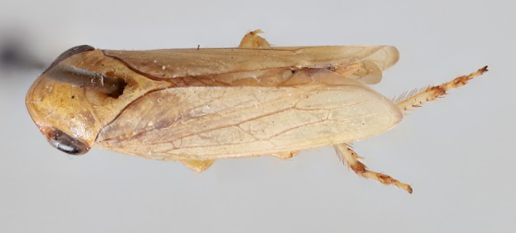
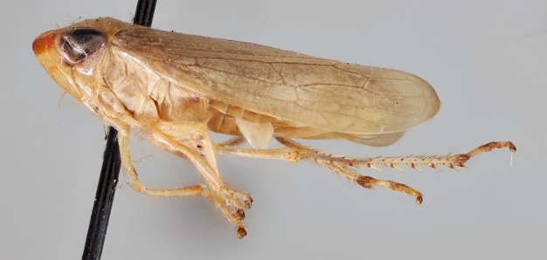
Tartesus ochraceus
Collected 9/21/1936 on Phyllanthus mariannensis in Piti

Slide 9
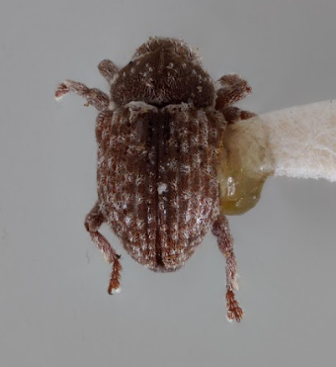
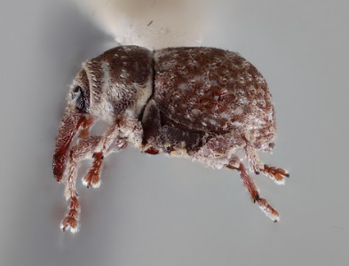
Swezeyella muscosa (Zimmerman)
Collected 6/2/1936 (has never been collected on any other plant)

Slide 10
Some of the insects collected on P. mariannensis and other plants:

Slide 11
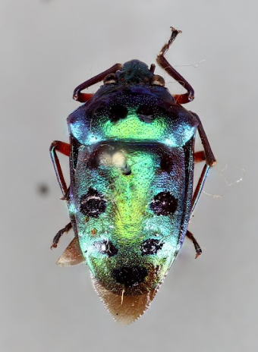
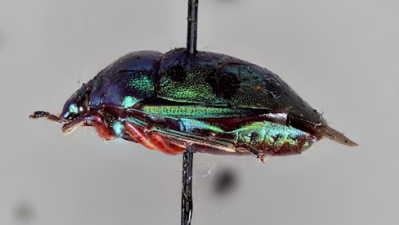
Calliphara munda (Stal)
Collected 8/18/1936 from Phyllanthus mariannensis in Piti

Slide 12
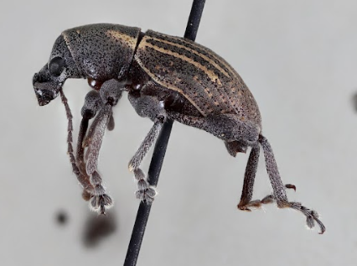
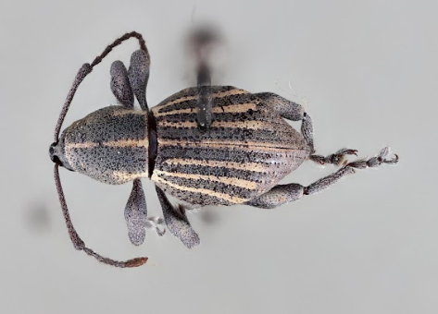
Trigonops inaequalis
Collected 7/17/1936 on Phyllanthus mariannensis

Slide 13
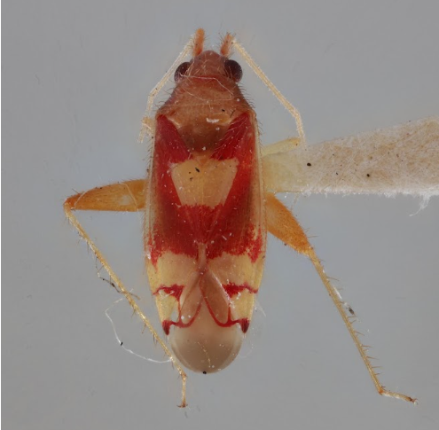
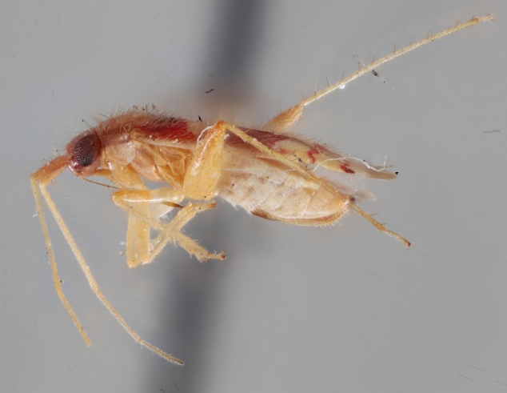
Aretas signatus (Unsinger)
Collected 1936

Slide 14
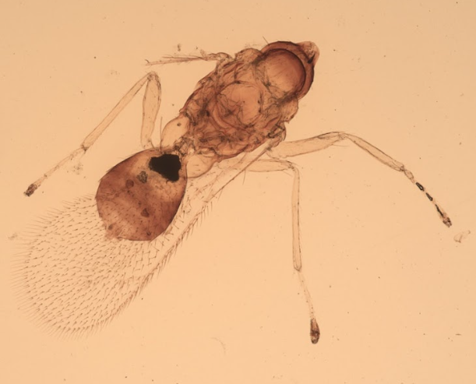
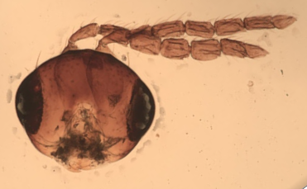
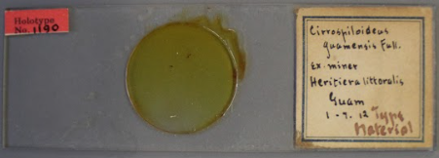
Cirrosphiloideus (now Elachertus?) guamensis (Full.)
Collected 1/7/1912

Slide 15
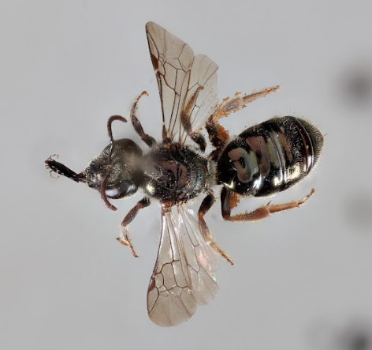
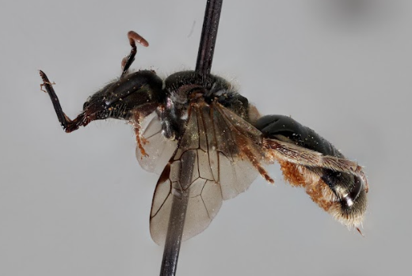
Halictus swezeyi
Collected 6/11/1936

Slide 16
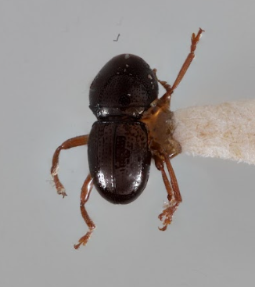
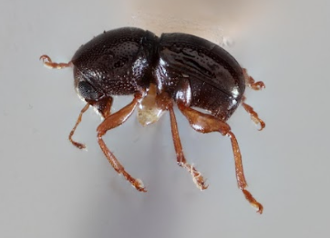
Notioxenus fulgidus (Zimmerman)
Collected 5/24/1936

Slide 17
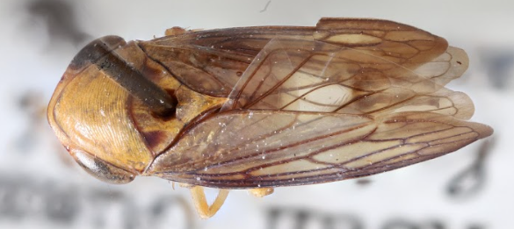
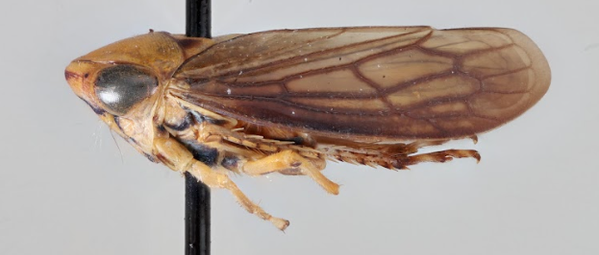
Tartessus swezeyi
Collected ?

Slide 18
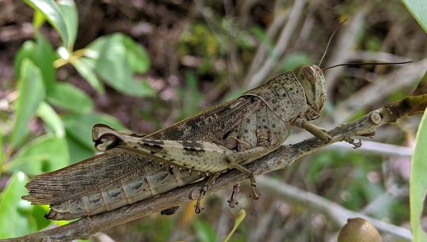
Valanga excavata
2020 photo by Dr. Ken Puliafico

Slide 19
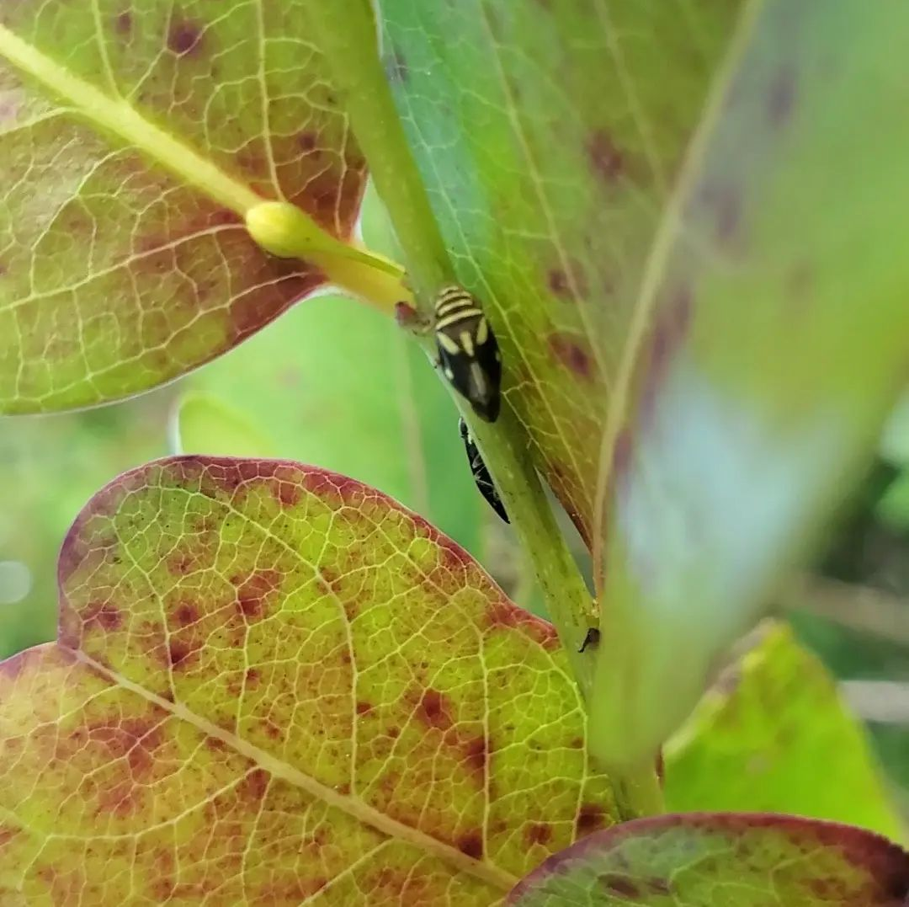
New sightings
Lallemandana phalerata
8/18/2021
NCS, Dededo

Slide 20
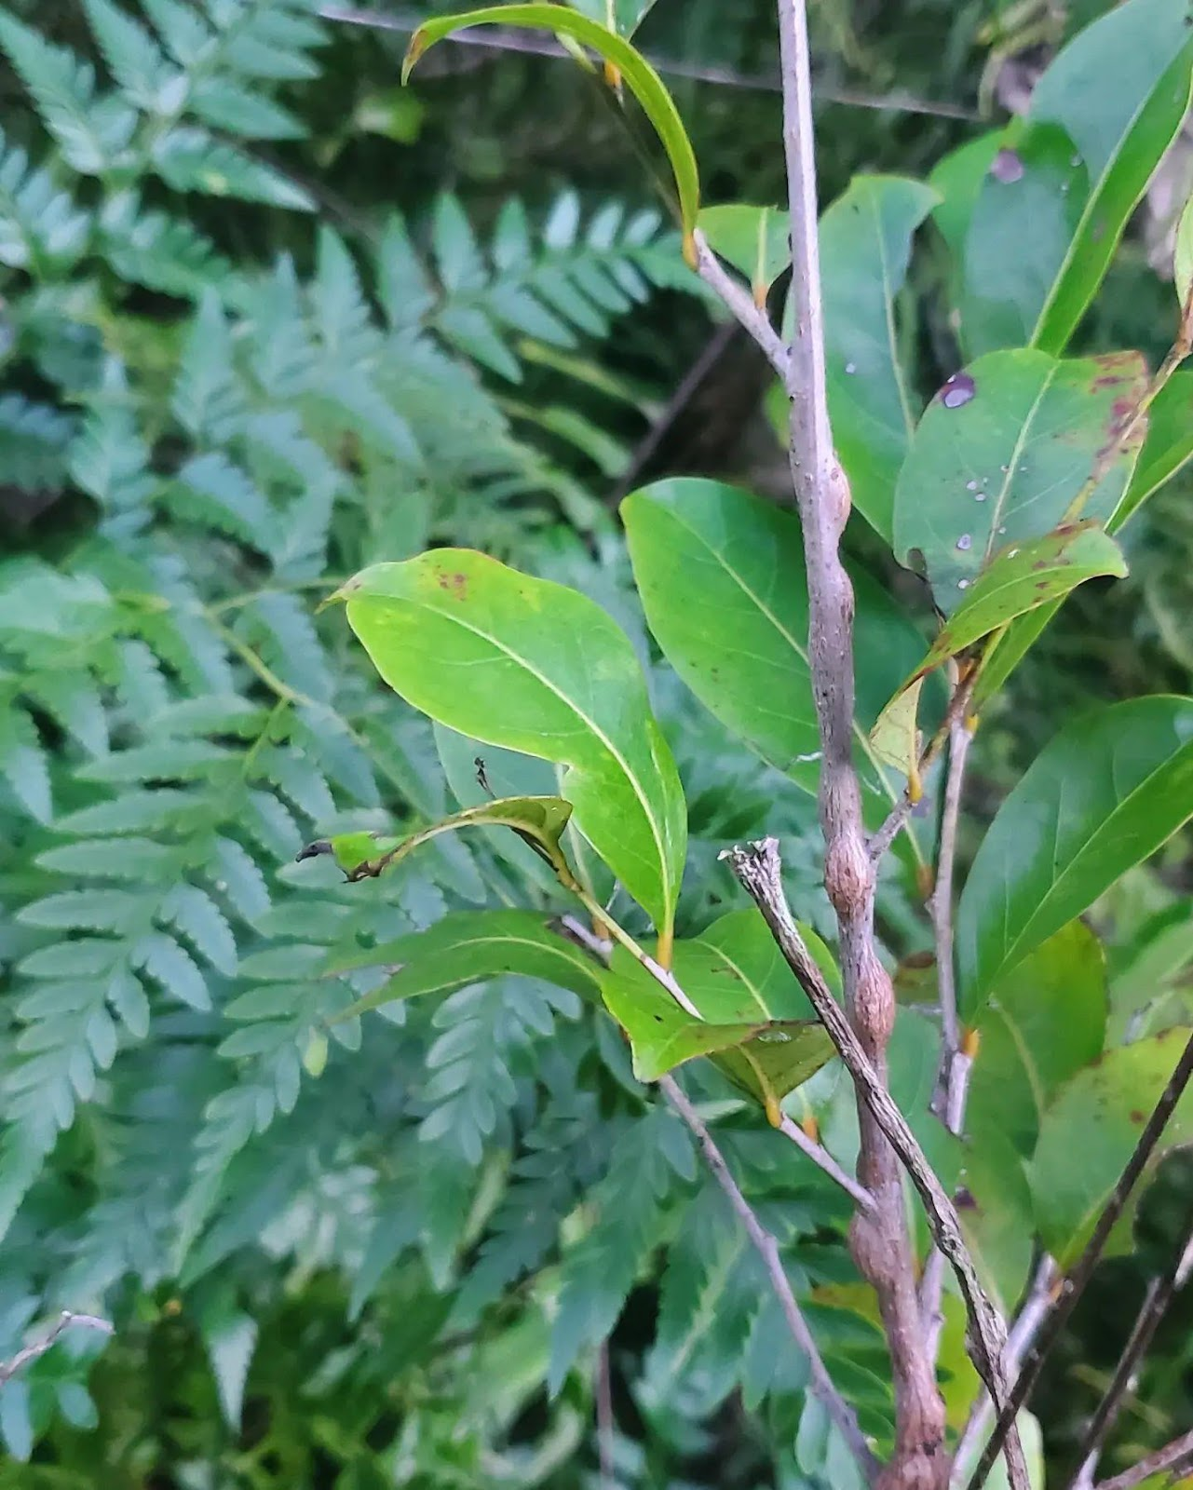
What is in the chosga stems?

Slide 21
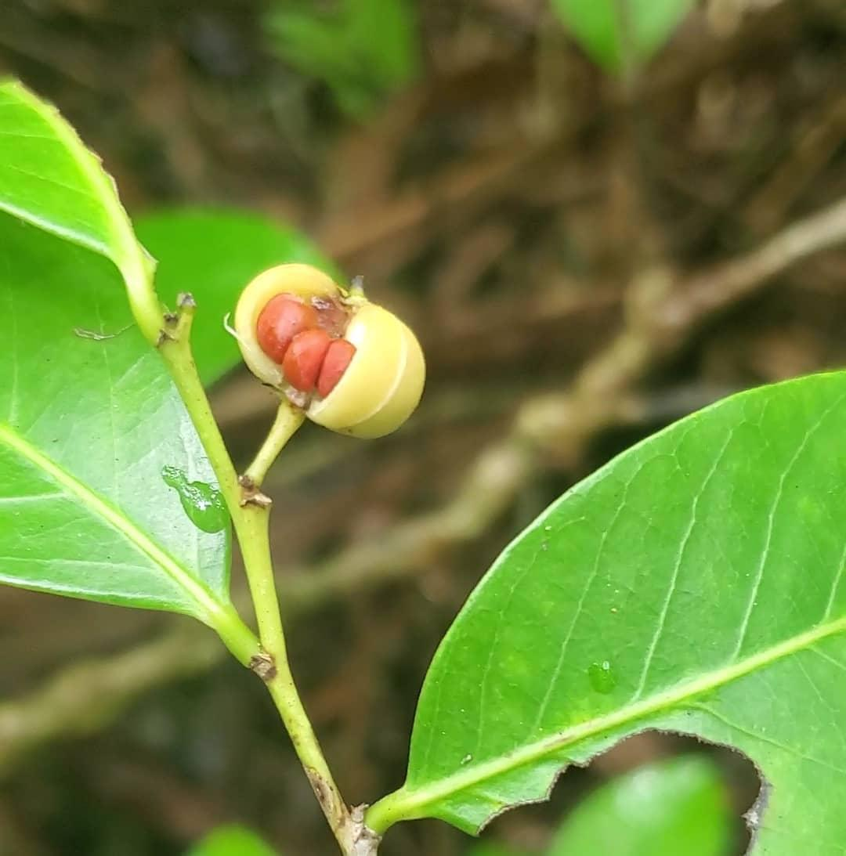
Is there anything inside the seeds?
Does Guam have an Epicephala moth?
The relationship between Episephala and Glochidion is 1 of 3 known instances of a specialized relationship of trading edible seeds for pollination, the others being figs and yucca.
Female Epicephala visits male flower
Then female flower, depositing pollen
Then ovipositing its eggs into the fruit
Pupae then eat some, but not all, of the seeds.
Mutualism has been found in ~500 species of Phyllanthus
Some species are pollinated by Epicephala, but without the seed-eating mutualism.
Mutualism is found more in the Glochidion subgenus
Often there is 1 Epicephala species for each Glochidion species.

Slide 22
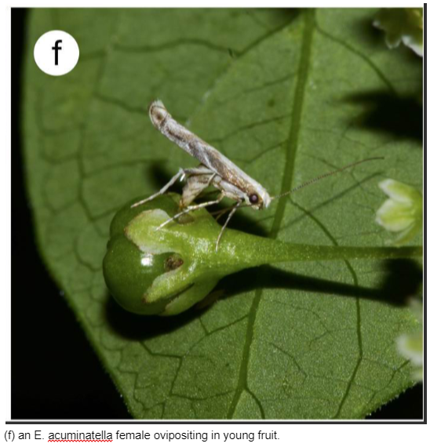
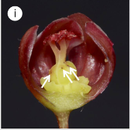
E. Anomala fruit with exit holes from Epicephala larva
“Within Polynesia and Micronesia, however, Epicephala have only been reported from Samoa [21] and the Marquesas Islands [22], suggesting that this mutualism may have been lost as Glochidion colonized the remote Pacific [23].”
PNAS 2003 “An obligate pollination mutualism and reciprocal diversification in the tree genus Glochidion (Euphorbiaceae)
Makoto Kato,* Atsushi Takimura, and Atsushi Kawakita

Slide 23
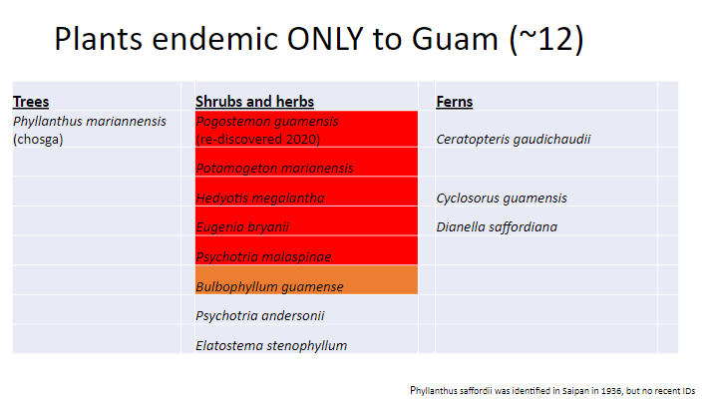
February 2023 plant of the month

Slide 24
